Slide 1
CSCE 689: Special Topics in Modern Algorithms for Data Science
Lecture 27
Samson Zhou

Slide 2
Presentation Schedule
November 27: Chunkai, Jung, Galaxy AI
November 29: STMI, Anmol, Jason
December 1: Bokun, Ayesha, Dawei, Lipai

Slide 3
Last Time: Linear Sketch
Suppose stream $S$induces a frequency vector $f$
Algorithm framework:
Generate a random matrix $A$ and maintain $A⋅f$
Apply a post-processing function $g(A⋅f)$ as the output
What algorithms have we discussed that fit this framework?
Notes:
Let’s start by breaking down each of the terms in the title. To understand the sliding window model, we first have to understand the streaming model of computation, in which elements of an underlying data set S, arrive sequentially and the goal is to evaluate or approximate some given function on this dataset, using space sublinear in S. In the sliding window model, only the W most recent updates form the underlying data set

Slide 4
Last Time: Sliding Window Model
Input: Elements of an underlying data set $S$, which arrives sequentially
Output: Evaluation (or approximation) of a given function
Goal: Use space sublinear in the size $m$of the input $S$
Sliding Window: “Only the $m$ most recent updates form the underlying data set $S$”
Emphasizes recent interactions, appropriate for time sensitive settings
1 0 1 1 1 0 0 1 1 0 1
Notes:
The sliding window model emphasizes recent data and thus is appropriate for settings that are time sensitive.

Slide 5
Last Time: Smooth Histogram
Converts a streaming algorithm for a smooth function into a sliding window algorithm

Slide 6
Last Time: Smooth Histogram
Start a new instance of the streaming algorithm (along with existing instances) each time a new element arrives
Each time there are three instances that report “close” values, delete the middle one
Use different checkpoints to “sandwich” the sliding window
1 0 1 1 1 0 0 1 1 0 1
Example: Number of ones in sliding window (2-approximation)
Number of ones in sliding window is at least 4 and at most 7
4 is a good approximation
7
4
2
1

Slide 7
Streaming Model
Input: Elements of an underlying data set $S$, which arrives sequentially
Output: Evaluation (or approximation) of a given function
Goal: Use space sublinear in the size $m$of the input $S$
Notes:
Let’s start by breaking down each of the terms in the title. To understand the sliding window model, we first have to understand the streaming model of computation, in which elements of an underlying data set S, arrive sequentially and the goal is to evaluate or approximate some given function on this dataset, using space sublinear in S. In the sliding window model, only the W most recent updates form the underlying data set

Slide 8
47 72 81 10 14 33 51 29 54 9 36 46 10

Slide 9
$$1$$
$$2$$
$$5$$
$$6$$
$$4$$
$$3$$

Slide 11
Streaming Model
We inherently assume the input is fixed in advance and thus independent of the algorithm
What if we need to interact with the algorithm multiple times?
Notes:
Let’s start by breaking down each of the terms in the title. To understand the sliding window model, we first have to understand the streaming model of computation, in which elements of an underlying data set S, arrive sequentially and the goal is to evaluate or approximate some given function on this dataset, using space sublinear in S. In the sliding window model, only the W most recent updates form the underlying data set

Slide 12
Case Study #1
Suppose we run the same algorithm on multiple datasets. Do we know how to handle this?
Notes:
Let’s start by breaking down each of the terms in the title. To understand the sliding window model, we first have to understand the streaming model of computation, in which elements of an underlying data set S, arrive sequentially and the goal is to evaluate or approximate some given function on this dataset, using space sublinear in S. In the sliding window model, only the W most recent updates form the underlying data set

Slide 13
Case Study #1
Suppose we run the same algorithm on multiple datasets. Do we know how to handle this? YES (union bound)
Notes:
Let’s start by breaking down each of the terms in the title. To understand the sliding window model, we first have to understand the streaming model of computation, in which elements of an underlying data set S, arrive sequentially and the goal is to evaluate or approximate some given function on this dataset, using space sublinear in S. In the sliding window model, only the W most recent updates form the underlying data set

Slide 14
Case Study #2
Suppose I have a batch of queries for a randomized database algorithm. Do we know how to handle this?
Notes:
Let’s start by breaking down each of the terms in the title. To understand the sliding window model, we first have to understand the streaming model of computation, in which elements of an underlying data set S, arrive sequentially and the goal is to evaluate or approximate some given function on this dataset, using space sublinear in S. In the sliding window model, only the W most recent updates form the underlying data set

Slide 15
Case Study #2
Suppose I have a batch of queries for a randomized database algorithm. Do we know how to handle this? YES, if the batch of queries is fixed in advance
Notes:
Let’s start by breaking down each of the terms in the title. To understand the sliding window model, we first have to understand the streaming model of computation, in which elements of an underlying data set S, arrive sequentially and the goal is to evaluate or approximate some given function on this dataset, using space sublinear in S. In the sliding window model, only the W most recent updates form the underlying data set

Slide 16
Case Study #3
Suppose I ask a sequence of queries for a randomized database algorithm. Do we know how to handle this?
Notes:
Let’s start by breaking down each of the terms in the title. To understand the sliding window model, we first have to understand the streaming model of computation, in which elements of an underlying data set S, arrive sequentially and the goal is to evaluate or approximate some given function on this dataset, using space sublinear in S. In the sliding window model, only the W most recent updates form the underlying data set

Slide 17
Case Study #3
Suppose I ask a sequence of queries for a randomized database algorithm. Do we know how to handle this? YES, if the batch of queries is fixed in advance, NO if each query can depend on the answer to previous queries
In the latter case, future inputs may not be independent of the algorithm’s randomness
Notes:
Let’s start by breaking down each of the terms in the title. To understand the sliding window model, we first have to understand the streaming model of computation, in which elements of an underlying data set S, arrive sequentially and the goal is to evaluate or approximate some given function on this dataset, using space sublinear in S. In the sliding window model, only the W most recent updates form the underlying data set

Slide 18


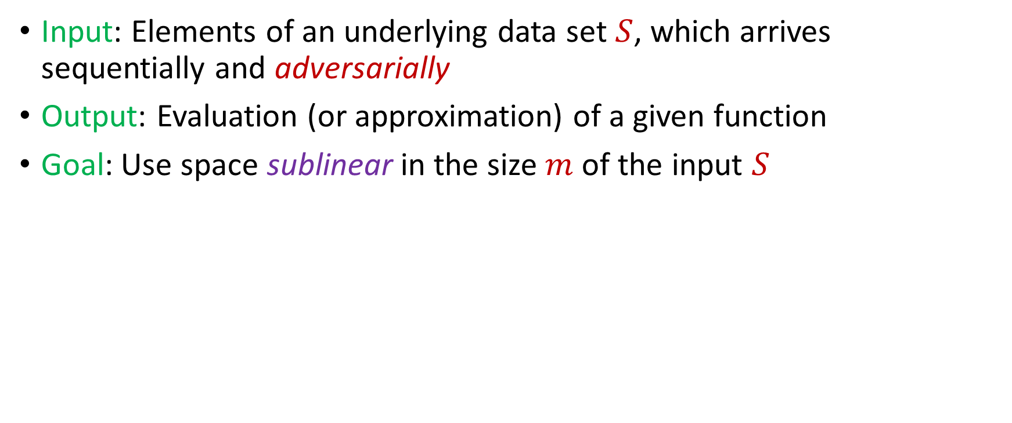
Adversarially Robust Streaming
Input: Elements of an underlying data set $S$, which arrives sequentially and adversarially
Output: Evaluation (or approximation) of a given function
Goal: Use space sublinear in the size $m$of the input $S$
1
1
Notes:
Let’s start by breaking down each of the terms in the title. To understand the sliding window model, we first have to understand the streaming model of computation, in which elements of an underlying data set S, arrive sequentially and the goal is to evaluate or approximate some given function on this dataset, using space sublinear in S. In the sliding window model, only the W most recent updates form the underlying data set

Slide 19
Adversarially Robust Streaming
Input: Elements of an underlying data set $S$, which arrives sequentially and adversarially
Output: Evaluation (or approximation) of a given function
Goal: Use space sublinear in the size $m$of the input $S$
10
1
Notes:
Let’s start by breaking down each of the terms in the title. To understand the sliding window model, we first have to understand the streaming model of computation, in which elements of an underlying data set S, arrive sequentially and the goal is to evaluate or approximate some given function on this dataset, using space sublinear in S. In the sliding window model, only the W most recent updates form the underlying data set

Slide 20
Adversarially Robust Streaming
Input: Elements of an underlying data set $S$, which arrives sequentially and adversarially
Output: Evaluation (or approximation) of a given function
Goal: Use space sublinear in the size $m$of the input $S$
101
2
Notes:
Let’s start by breaking down each of the terms in the title. To understand the sliding window model, we first have to understand the streaming model of computation, in which elements of an underlying data set S, arrive sequentially and the goal is to evaluate or approximate some given function on this dataset, using space sublinear in S. In the sliding window model, only the W most recent updates form the underlying data set

Slide 21
Adversarially Robust Streaming
Input: Elements of an underlying data set $S$, which arrives sequentially and adversarially
Output: Evaluation (or approximation) of a given function
Goal: Use space sublinear in the size $m$of the input $S$
1010
3
Notes:
Let’s start by breaking down each of the terms in the title. To understand the sliding window model, we first have to understand the streaming model of computation, in which elements of an underlying data set S, arrive sequentially and the goal is to evaluate or approximate some given function on this dataset, using space sublinear in S. In the sliding window model, only the W most recent updates form the underlying data set

Slide 22

Adversarially Robust Streaming
Input: Elements of an underlying data set $S$, which arrives sequentially and adversarially
Output: Evaluation (or approximation) of a given function
Goal: Use space sublinear in the size $m$of the input $S$
1010
3
Notes:
Let’s start by breaking down each of the terms in the title. To understand the sliding window model, we first have to understand the streaming model of computation, in which elements of an underlying data set S, arrive sequentially and the goal is to evaluate or approximate some given function on this dataset, using space sublinear in S. In the sliding window model, only the W most recent updates form the underlying data set

Slide 23
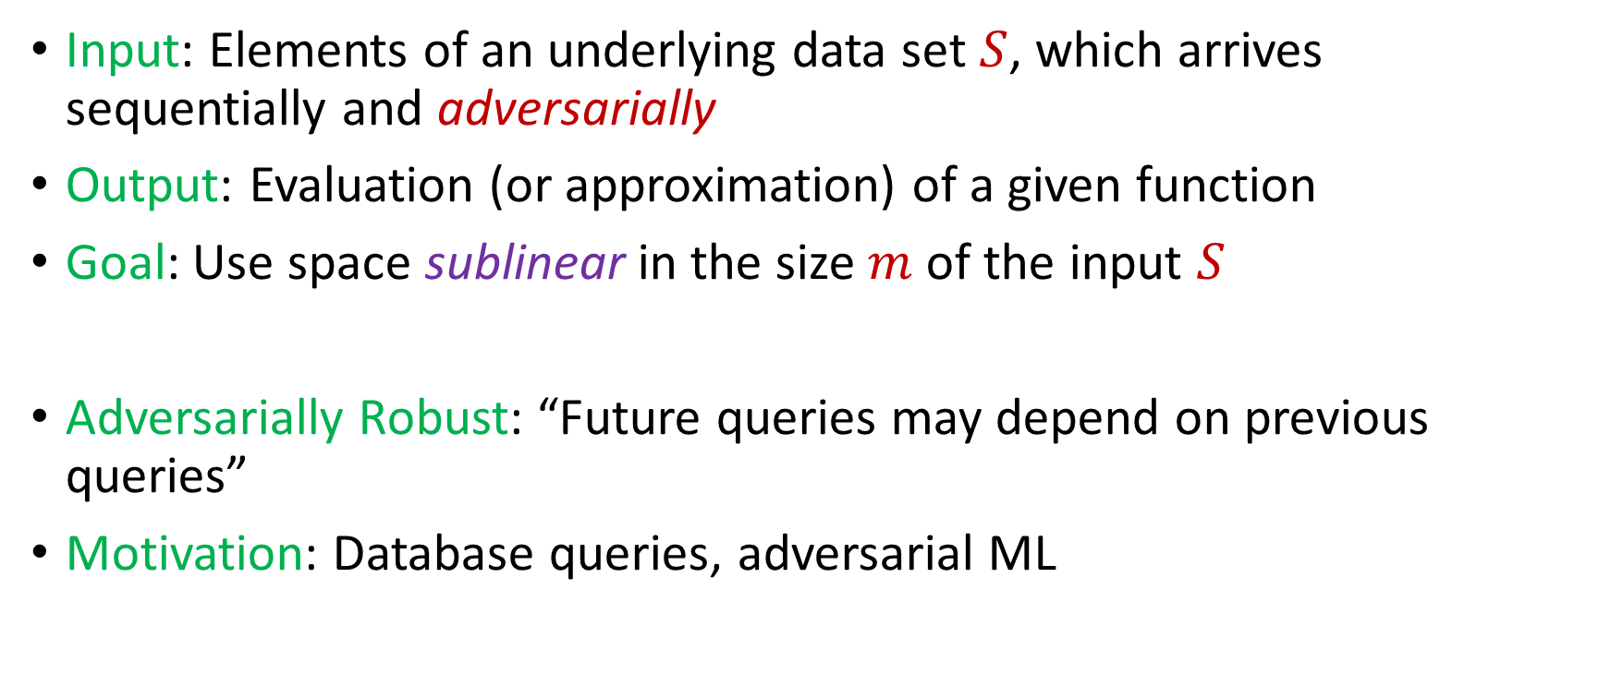
Adversarially Robust Streaming
Input: Elements of an underlying data set $S$, which arrives sequentially and adversarially
Output: Evaluation (or approximation) of a given function
Goal: Use space sublinear in the size $m$of the input $S$
Adversarially Robust: “Future queries may depend on previous queries”
Motivation: Database queries, adversarial ML
Notes:
Let’s start by breaking down each of the terms in the title. To understand the sliding window model, we first have to understand the streaming model of computation, in which elements of an underlying data set S, arrive sequentially and the goal is to evaluate or approximate some given function on this dataset, using space sublinear in S. In the sliding window model, only the W most recent updates form the underlying data set

Slide 24

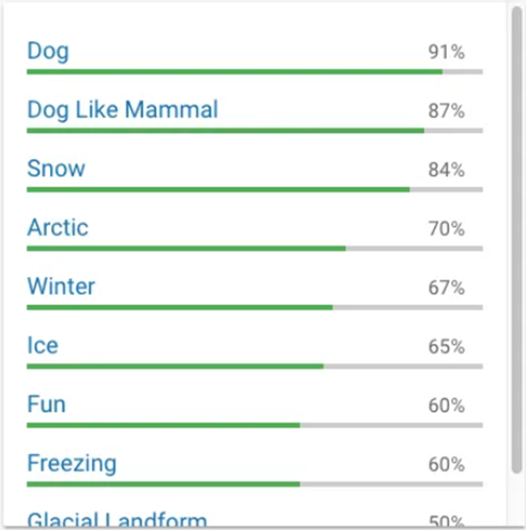
Human readers will easily identify the image as showing two men on skis. Google’s Cloud Vision service reported being 91 percent certain it saw a dog. Other stunts have shown how to make stop signs invisible, or audio that sounds benign to humans but is transcribed by software as “OK Google browse to evil dot com.”

Slide 25
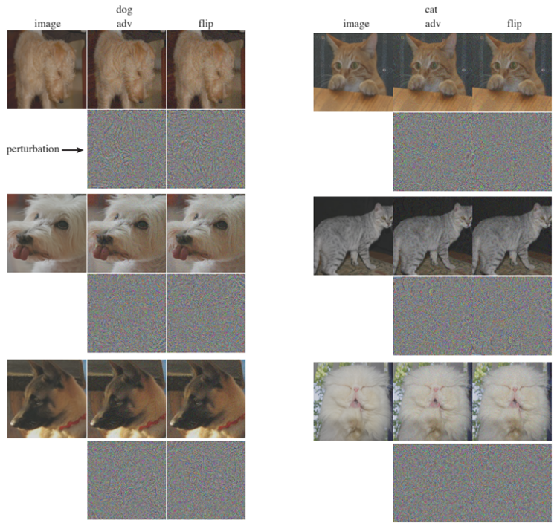

Slide 26
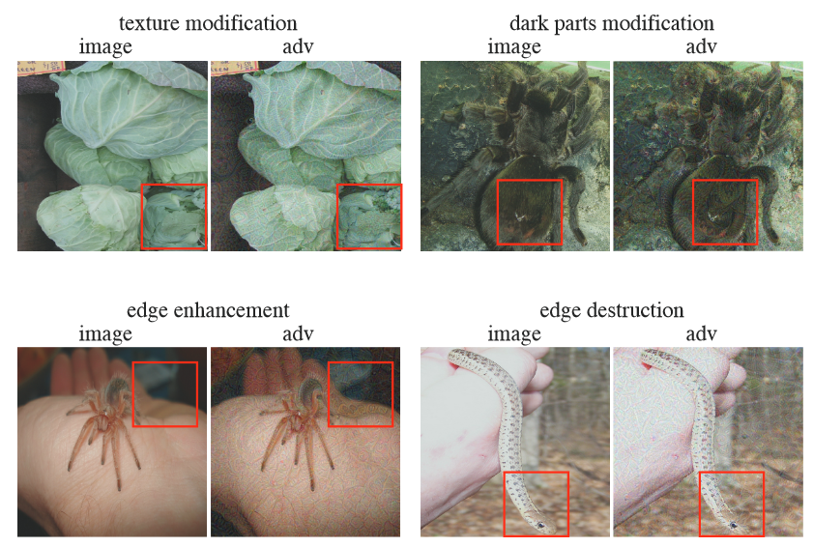

Slide 27
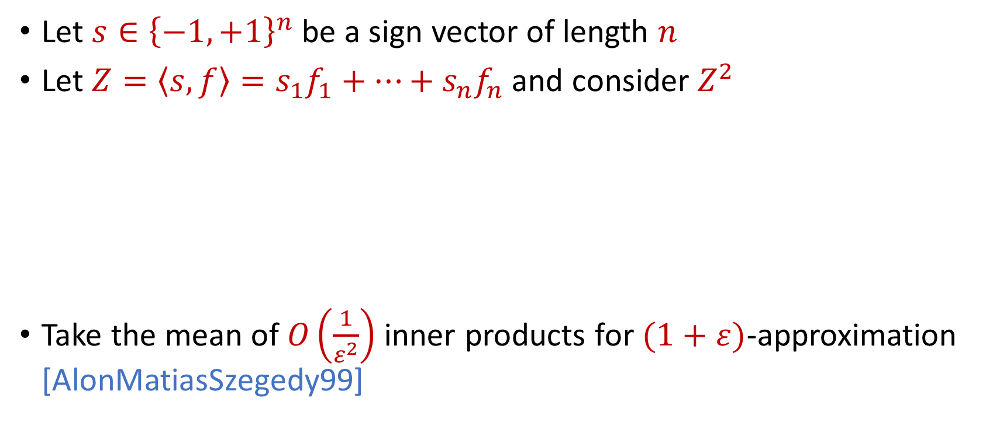

AMS $F_{2}$Algorithm
Let $s∈{\left\{−1,+1\right\}}^{n}$ be a sign vector of length $n$
Let $Z=\left\langle s,f\right\rangle =s_{1}f_{1}+…+s_{n}f_{n}$ and consider $Z^{2}$
Take the mean of $O\left(\frac{1}{ε^{2}}\right)$ inner products for $(1+ε)$-approximation [AlonMatiasSzegedy99]
$E\left[Z^{2}\right]=$ $\sum_{i,j}{E\left[s_{i}s_{j}f_{i}f_{j}\right]}=f_{1}^{2}+…+f_{n}^{2}$
$Var\left[Z^{2}\right]≤$ $\sum_{i,j}{E\left[s_{i}s_{j}s_{k}s_{l}f_{i}f_{j}f_{k}f_{l}\right]}≤2F_{2}^{2}$

Slide 28
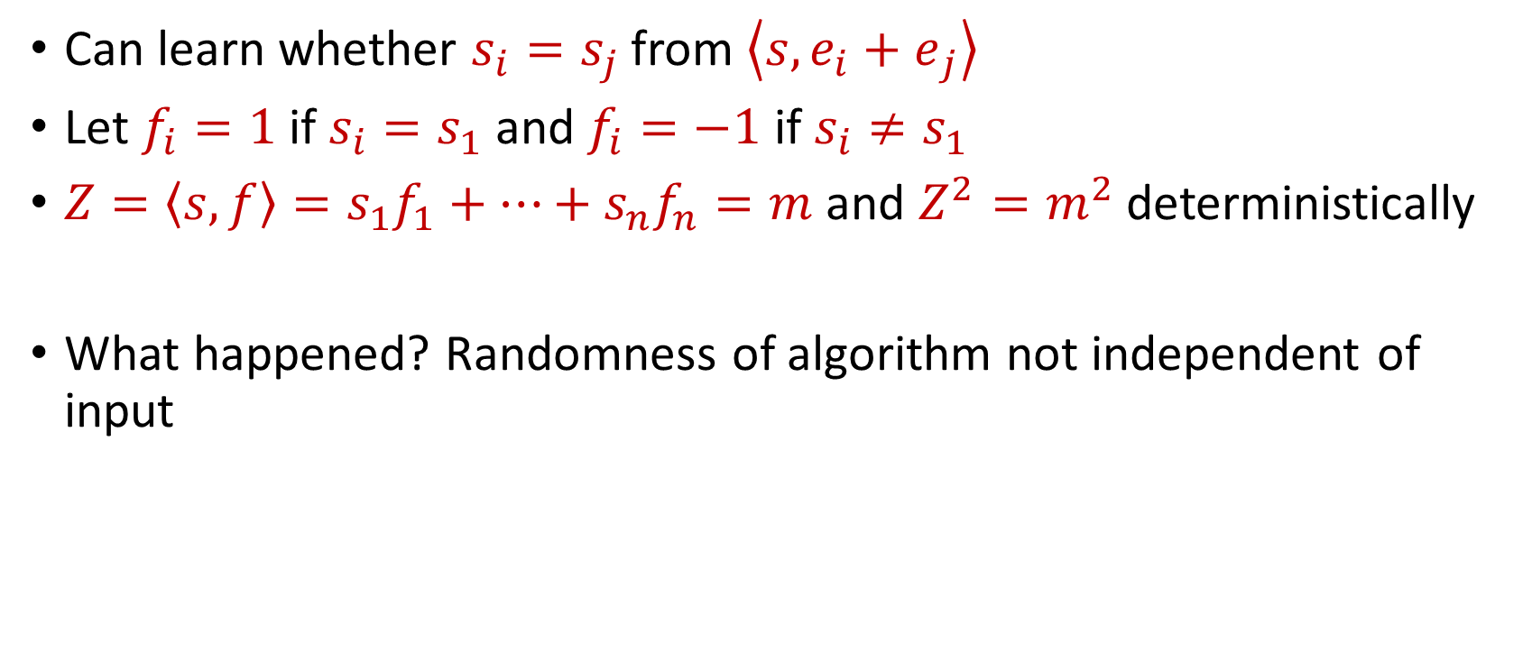
“Attack” on AMS
Can learn whether $s_{i}=s_{j}$ from $\left\langle s,{e_{i}+e}_{j}\right\rangle$
Let $f_{i}=1$ if $s_{i}=s_{1}$ and $f_{i}=−1$ if $s_{i}≠s_{1}$
$Z=\left\langle s,f\right\rangle =s_{1}f_{1}+…+s_{n}f_{n}=m$ and $Z^{2}=m^{2}$ deterministically
What happened? Randomness of algorithm not independent of input

Slide 29
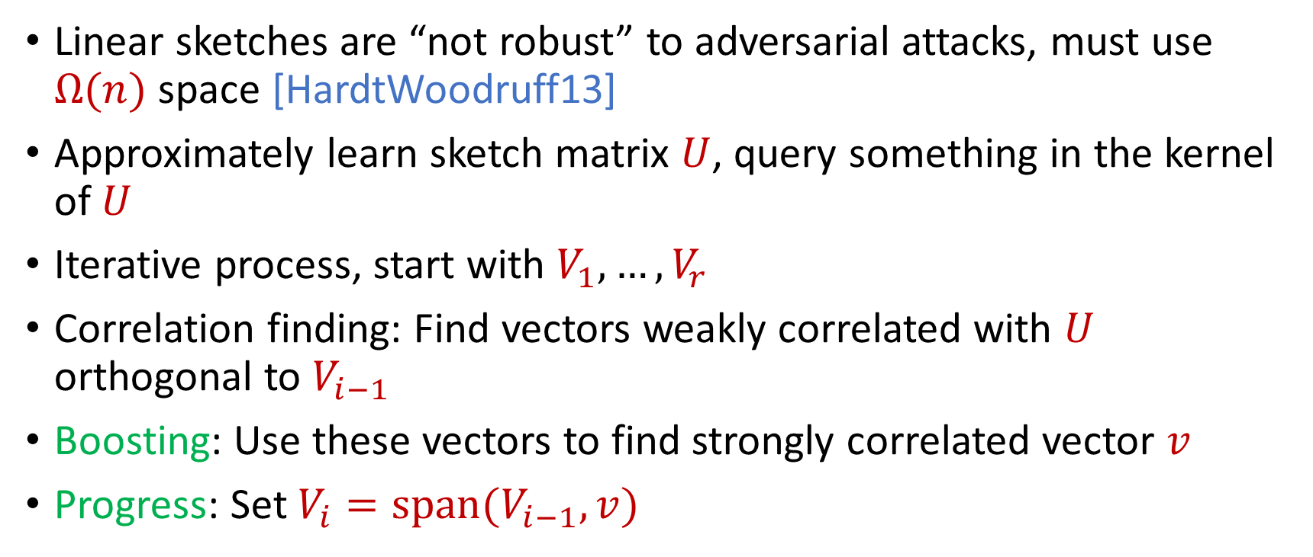
Reconstruction Attack on Linear Sketches
Linear sketches are “not robust” to adversarial attacks, must use $Ω(n)$ space [HardtWoodruff13]
Approximately learn sketch matrix $U$, query something in the kernel of $U$
Iterative process, start with $V_{1},…,V_{r}$
Correlation finding: Find vectors weakly correlated with $U$ orthogonal to $V_{i−1}$
Boosting: Use these vectors to find strongly correlated vector $v$
Progress: Set $V_{i}=span(V_{i−1},v)$

Slide 30
Insertion-Only Streams
Key: Deletions are needed to perform this attack
Similar lower bounds for the sliding window model [DatarGionisIndykMotwani02]
Assume insertion-only updates
How do the previous results work?

Slide 31
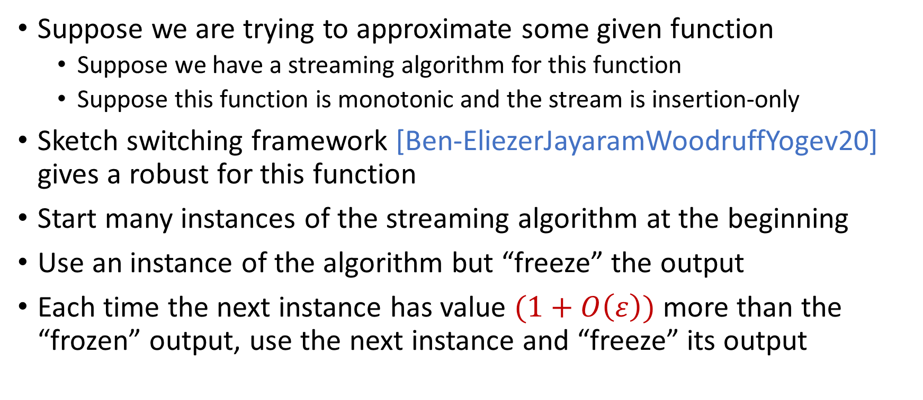
Robust Algorithms
Suppose we are trying to approximate some given function
Suppose we have a streaming algorithm for this function
Suppose this function is monotonic and the stream is insertion-only
Sketch switching framework [Ben-EliezerJayaramWoodruffYogev20] gives a robust for this function
Start many instances of the streaming algorithm at the beginning
Use an instance of the algorithm but “freeze” the output
Each time the next instance has value $(1+O\left(ε\right))$ more than the “frozen” output, use the next instance and “freeze” its output

Slide 32
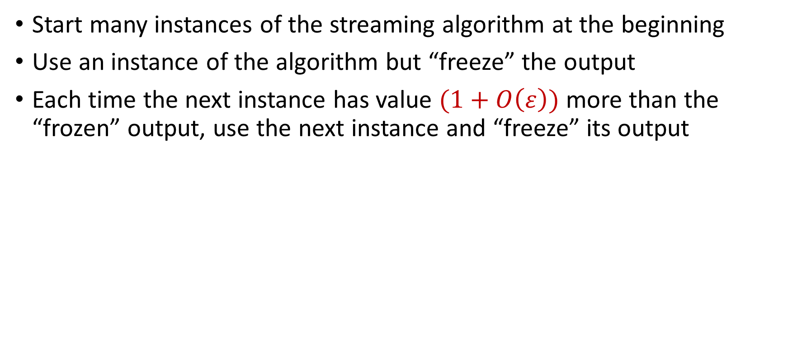
Sketch Switching
Start many instances of the streaming algorithm at the beginning
Use an instance of the algorithm but “freeze” the output
Each time the next instance has value $(1+O\left(ε\right))$ more than the “frozen” output, use the next instance and “freeze” its output
1
Example: Number of ones in the stream (2-approximation)
1
1
1
1

Slide 33

Sketch Switching
Start many instances of the streaming algorithm at the beginning
Use an instance of the algorithm but “freeze” the output
Each time the next instance has value $(1+O\left(ε\right))$ more than the “frozen” output, use the next instance and “freeze” its output
1 0
Example: Number of ones in the stream (2-approximation)
1
1
1
1

Slide 34
Sketch Switching
Start many instances of the streaming algorithm at the beginning
Use an instance of the algorithm but “freeze” the output
Each time the next instance has value $(1+O\left(ε\right))$ more than the “frozen” output, use the next instance and “freeze” its output
1 0 1
Example: Number of ones in the stream (2-approximation)
1
2
2
2

Slide 35
Sketch Switching
Start many instances of the streaming algorithm at the beginning
Use an instance of the algorithm but “freeze” the output
Each time the next instance has value $(1+O\left(ε\right))$ more than the “frozen” output, use the next instance and “freeze” its output
1 0 1
Example: Number of ones in the stream (2-approximation)
1
2
2
2

Slide 36
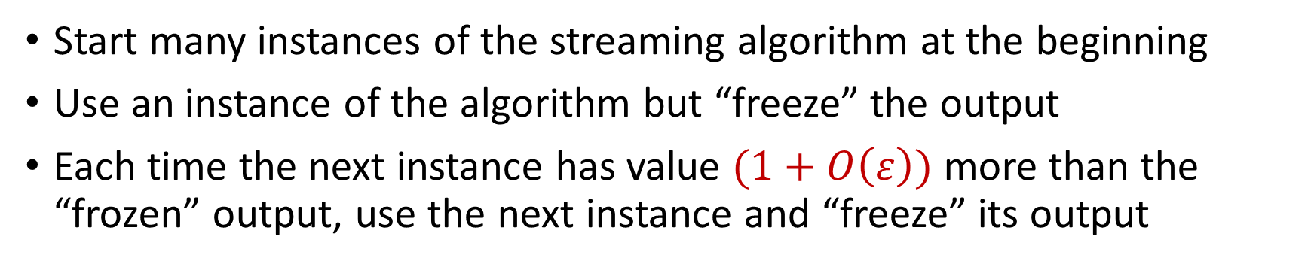
Sketch Switching
Start many instances of the streaming algorithm at the beginning
Use an instance of the algorithm but “freeze” the output
Each time the next instance has value $(1+O\left(ε\right))$ more than the “frozen” output, use the next instance and “freeze” its output
1 0 1 1
Example: Number of ones in the stream (2-approximation)
1
2
3
3

Slide 37
Sketch Switching
Start many instances of the streaming algorithm at the beginning
Use an instance of the algorithm but “freeze” the output
Each time the next instance has value $(1+O\left(ε\right))$ more than the “frozen” output, use the next instance and “freeze” its output
1 0 1 1 1
Example: Number of ones in the stream (2-approximation)
1
2
4
4

Slide 38
Sketch Switching
Start many instances of the streaming algorithm at the beginning
Use an instance of the algorithm but “freeze” the output
Each time the next instance has value $(1+O\left(ε\right))$ more than the “frozen” output, use the next instance and “freeze” its output
1 0 1 1 1
Example: Number of ones in the stream (2-approximation)
1
2
4
4

Slide 39
Sketch Switching
Start many instances of the streaming algorithm at the beginning
Use an instance of the algorithm but “freeze” the output
Each time the next instance has value $(1+O\left(ε\right))$ more than the “frozen” output, use the next instance and “freeze” its output
1 0 1 1 1 0 0 1 1 0 1
Example: Number of ones in the stream (2-approximation)
Number of ones stream is at least 4 and at most 8
4 is a good approximation
1
2
4
7

Slide 40
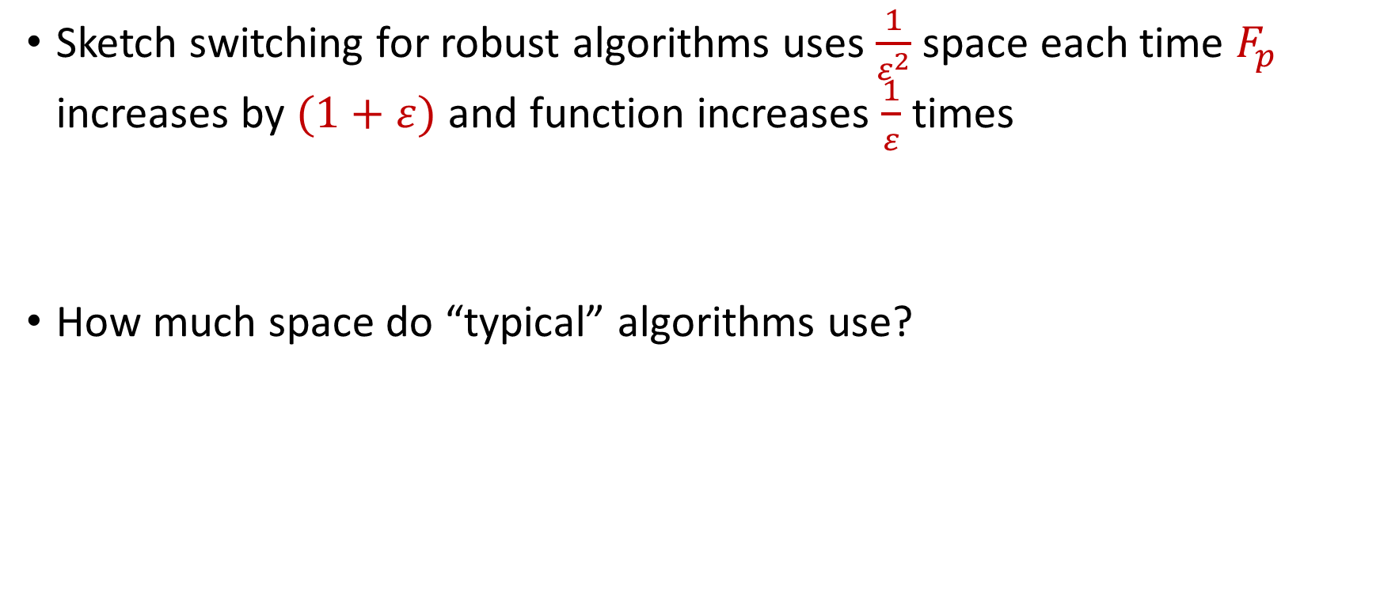
Sketch Switching Summary
Sketch switching for robust algorithms uses $\frac{1}{ε^{2}}$ space each time $F_{p}$ increases by $(1+ε)$ and function increases $\frac{1}{ε}$ times
How much space do “typical” algorithms use?

Slide 41
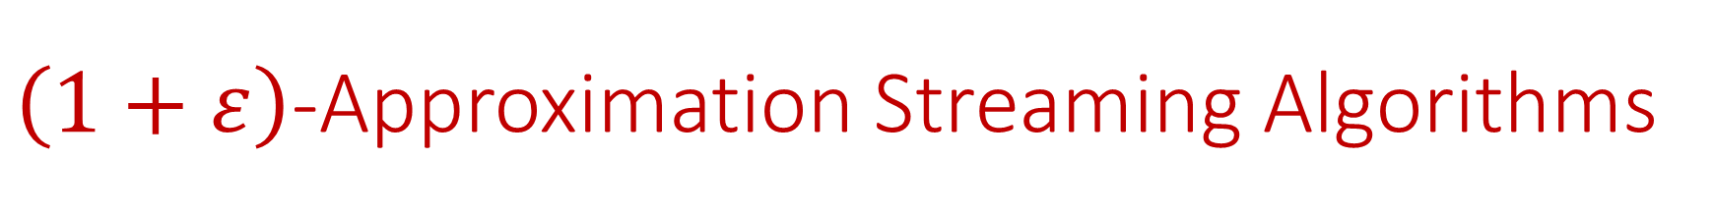
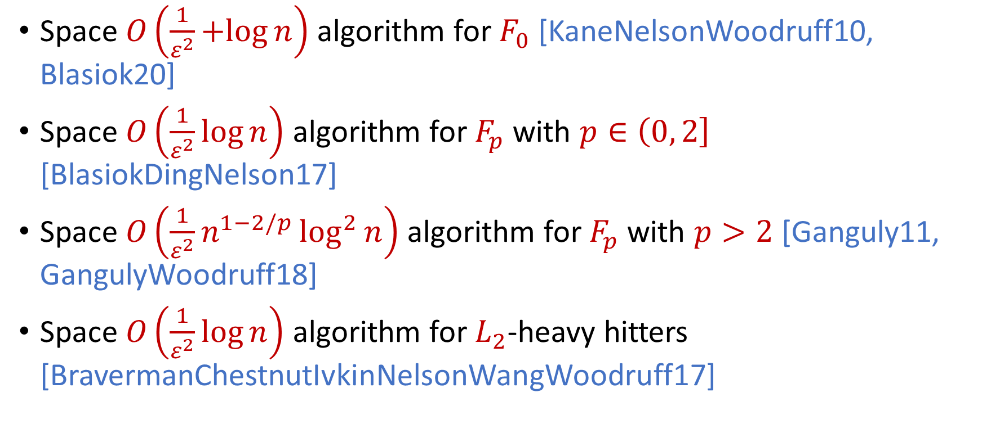
$\left(1+ε\right)$-Approximation Streaming Algorithms
Space $O\left(\frac{1}{ε^{2}}+log{n}\right)$ algorithm for $F_{0}$ [KaneNelsonWoodruff10, Blasiok20]
Space $O\left(\frac{1}{ε^{2}}\log{n}\right)$ algorithm for $F_{p}$ with $p∈\left(0, 2\right]$ [BlasiokDingNelson17]
Space $O\left(\frac{1}{ε^{2}}n^{1−2/p}\log^{2}{n}\right)$ algorithm for $F_{p}$ with $p>2$ [Ganguly11, GangulyWoodruff18]
Space $O\left(\frac{1}{ε^{2}}\log{n}\right)$ algorithm for $L_{2}$-heavy hitters [BravermanChestnutIvkinNelsonWangWoodruff17]

Slide 42
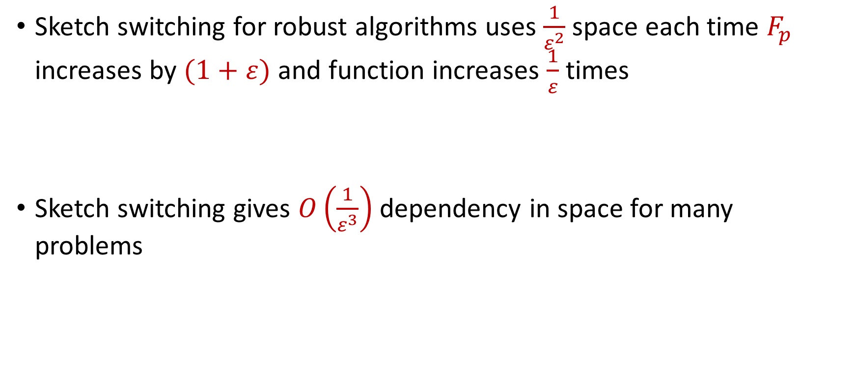
Sketch Switching Summary
Sketch switching for robust algorithms uses $\frac{1}{ε^{2}}$ space each time $F_{p}$ increases by $(1+ε)$ and function increases $\frac{1}{ε}$ times
Sketch switching gives $O\left(\frac{1}{ε^{3}}\right)$ dependency in space for many problems

Slide 43
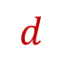

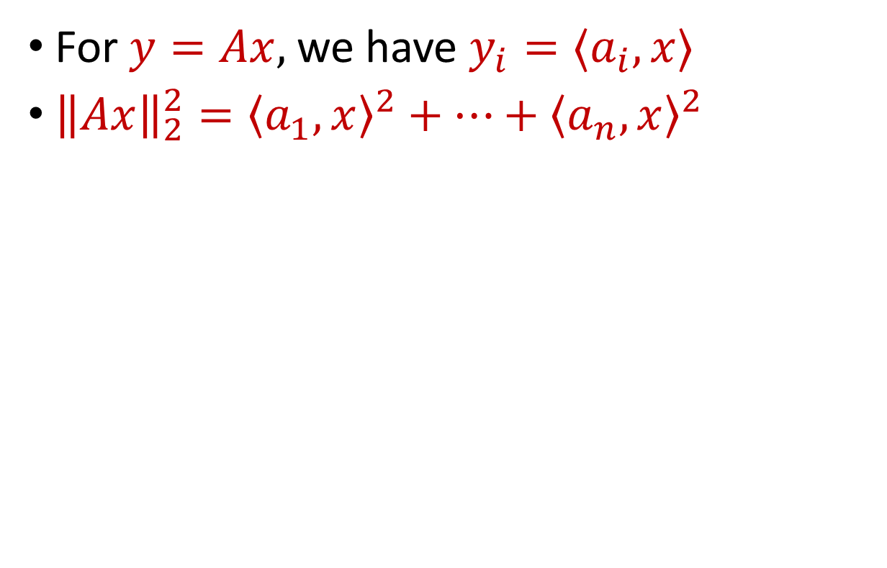
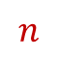
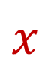

Linear Algebra Review
For $y=Ax$, we have $y_{i}=⟨a_{i}, x⟩$
${\left\|Ax\right\|}_{2}^{2}={\left\langle a_{1}, x\right\rangle }^{2}+…+{\left\langle a_{n}, x\right\rangle }^{2}$
$$A$$
$$x$$
$$d$$
$$n$$
$$d$$

Slide 44
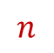
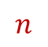
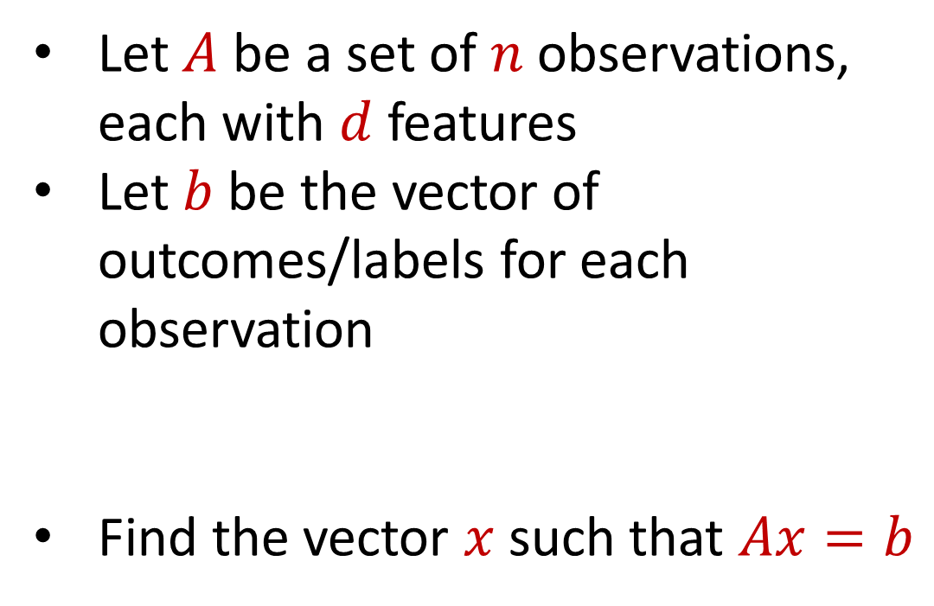
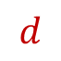
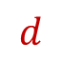
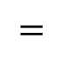
Regression
Let $A$ be a set of $n$ observations, each with $d$ features
Let $b$ be the vector of outcomes/labels for each observation
Find the vector $x$ such that $Ax=b$
$$d$$
$$x$$
$$=$$
$$n$$
$$A$$
$$n$$
$$b$$
$$1$$
$$d$$
$$1$$

Slide 45
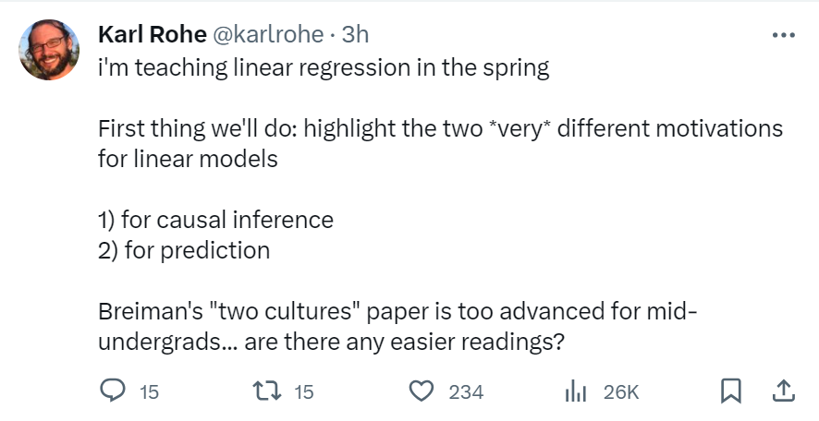

Slide 46


Regression
Economics and Finance:
Stock price prediction: Predict stock prices based on historical data and other relevant factors.
Econometric analysis: Study the relationships between economic variables like GDP, inflation, and interest rates.

Slide 47

Regression
Medicine and Healthcare:
Medical research: Understand the relationship between factors such as age, genetics, and lifestyle on health outcomes.
Disease prediction: Predicting the probability of disease occurrence based on risk factors like smoking, diet, and exercise.

Slide 48
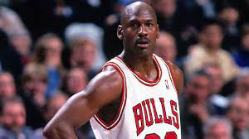

Regression
Sports Analytics:
Player performance forecast: Predicting player performance in sports like baseball, basketball, or soccer based on historical data.
Game outcome prediction: Predicting the outcome of games based on team statistics and other factors.

Slide 49

Regression
Environmental Science:
Climate modeling: Model climate change variables like temperature, precipitation, and sea levels.
Pollution analysis: Analyze the relationship between pollution levels and various factors like industrial activity and population.

Slide 50
Regression
Let $A$ be a set of $n$ observations, each with $d$ features
Let $b$ be the vector of outcomes/labels for each observation
Find the vector $x$ such that $Ax=b$
$$d$$
$$x$$
$$=$$
$$n$$
$$A$$
$$n$$
$$b$$
$$1$$
$$d$$
$$1$$

Slide 51
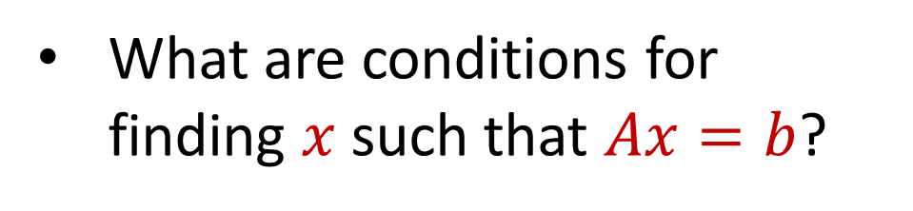
Linear Algebra Review
What are conditions for finding $x$ such that $Ax=b$?
$$d$$
$$x$$
$$=$$
$$n$$
$$A$$
$$n$$
$$b$$
$$1$$
$$d$$
$$1$$

Slide 52
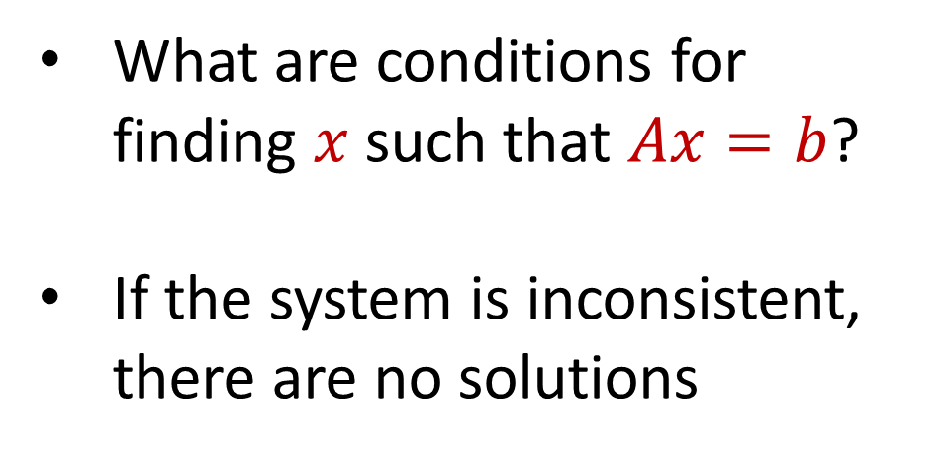
Linear Algebra Review
What are conditions for finding $x$ such that $Ax=b$?
If the system is inconsistent, there are no solutions
$$d$$
$$x$$
$$=$$
$$n$$
$$A$$
$$n$$
$$b$$
$$1$$
$$d$$
$$1$$

Slide 53
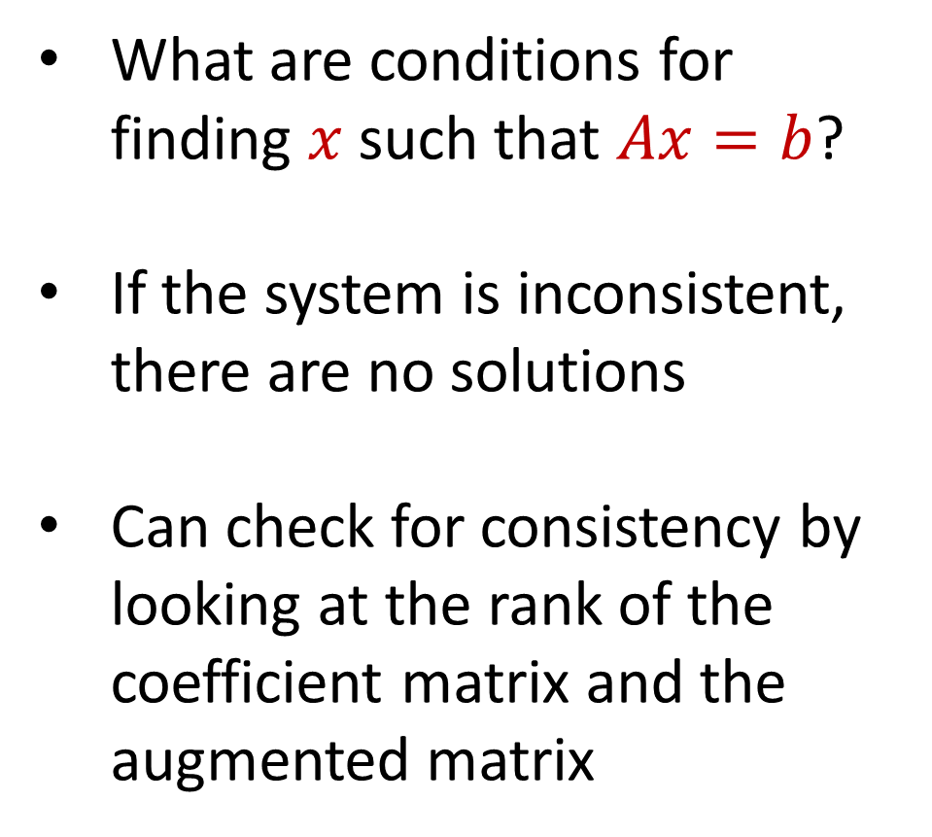
Linear Algebra Review
What are conditions for finding $x$ such that $Ax=b$?
If the system is inconsistent, there are no solutions
Can check for consistency by looking at the rank of the coefficient matrix and the augmented matrix
$$d$$
$$x$$
$$=$$
$$n$$
$$A$$
$$n$$
$$b$$
$$1$$
$$d$$
$$1$$

Slide 54
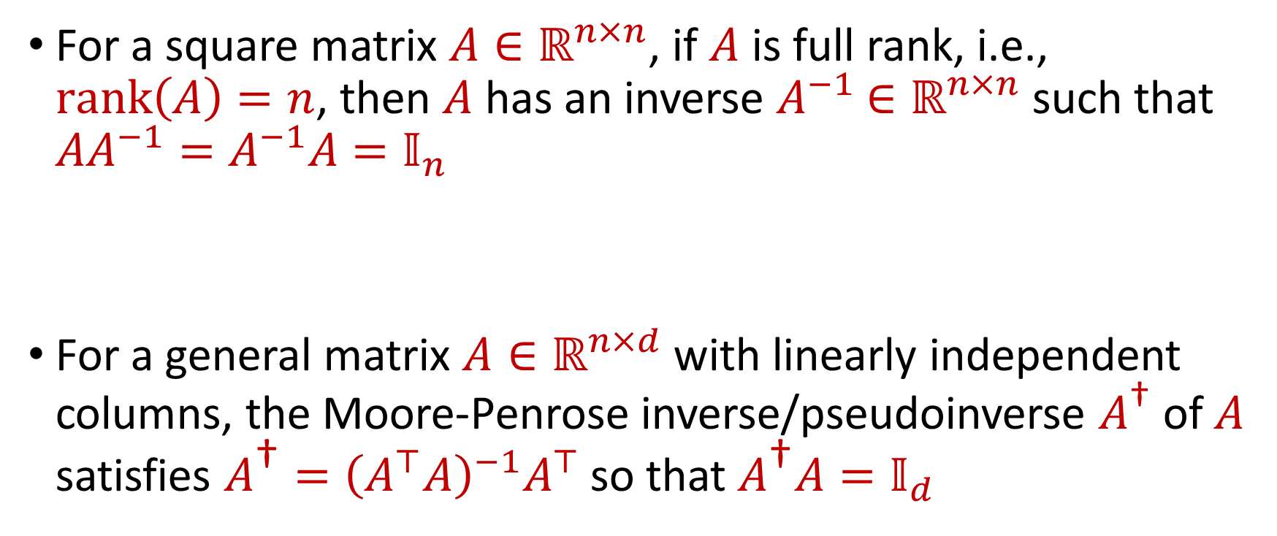
Linear Algebra Review
For a square matrix $A∈ℝ^{n×n}$, if $A$ is full rank, i.e., $rank\left(A\right)=n$, then $A$ has an inverse $A^{−1}$ $∈ℝ^{n×n}$ such that $AA^{−1}=A^{−1}A=𝕀_{n}$
For a general matrix $A∈ℝ^{n×d}$ with linearly independent columns, the Moore-Penrose inverse/pseudoinverse $A^{\text{†}}$ of $A$ satisfies $A^{\text{†}}={\left(A^{⊤}A\right)}^{−1}A^{⊤}$ so that $A^{\text{†}}A=𝕀_{d}$

Slide 55
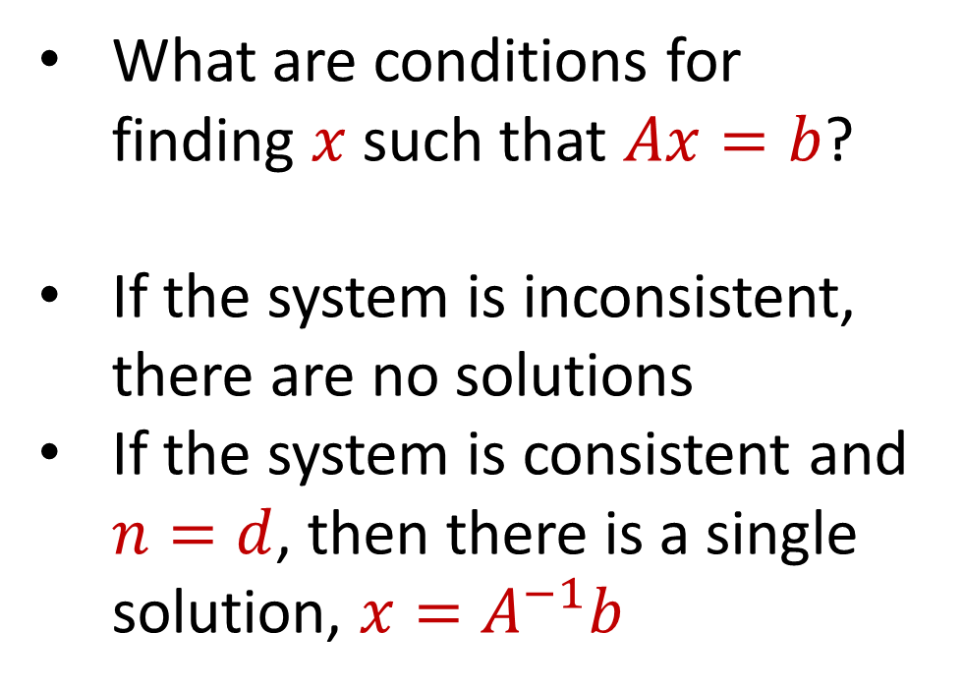
Linear Algebra Review
What are conditions for finding $x$ such that $Ax=b$?
If the system is inconsistent, there are no solutions
If the system is consistent and $n=d$, then there is a single solution, $x=A^{−1}b$
$$d$$
$$x$$
$$=$$
$$n$$
$$A$$
$$n$$
$$b$$
$$1$$
$$d$$
$$1$$

Slide 56
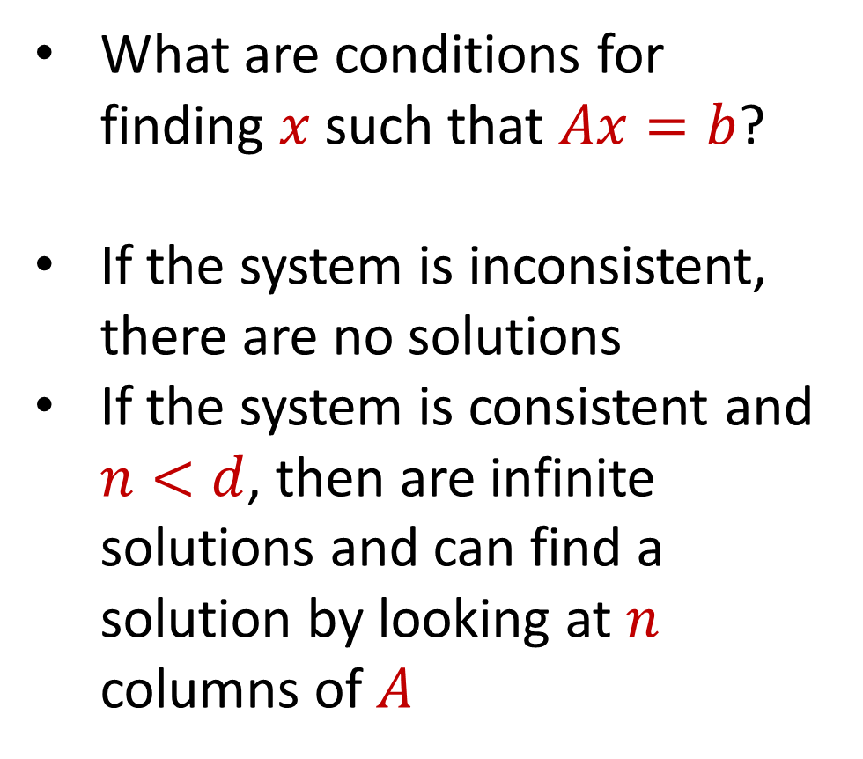
Linear Algebra Review
What are conditions for finding $x$ such that $Ax=b$?
If the system is inconsistent, there are no solutions
If the system is consistent and $n<d$, then are infinite solutions and can find a solution by looking at $n$ columns of $A$
$$d$$
$$x$$
$$=$$
$$n$$
$$A$$
$$n$$
$$b$$
$$1$$
$$d$$
$$1$$

Slide 57
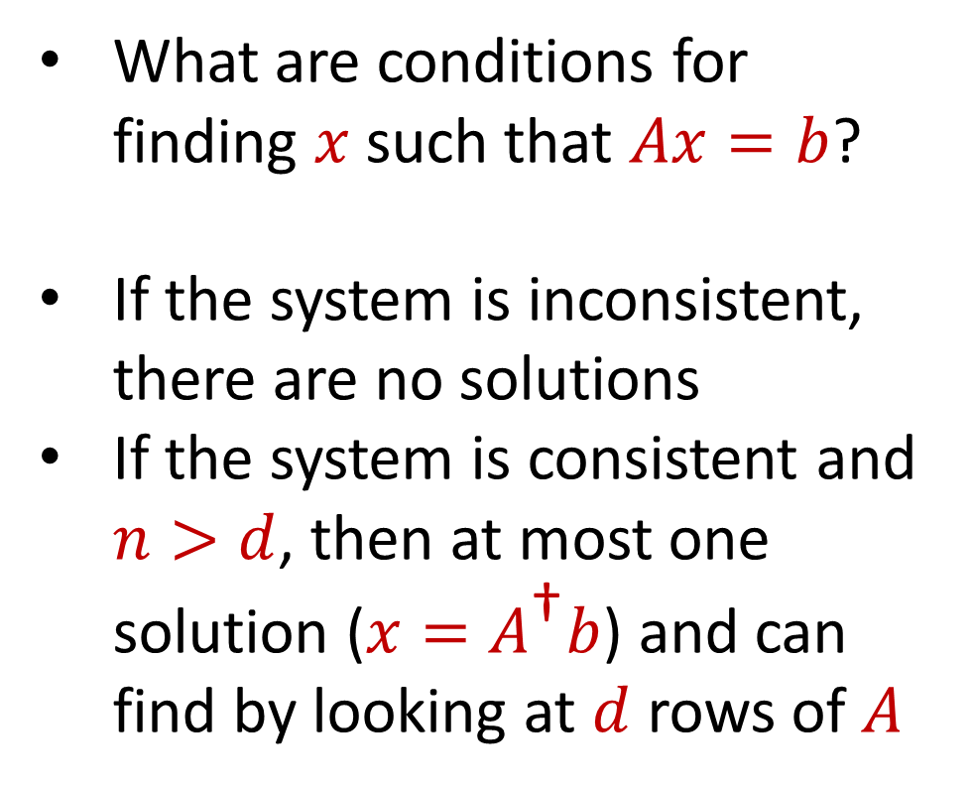
Linear Algebra Review
What are conditions for finding $x$ such that $Ax=b$?
If the system is inconsistent, there are no solutions
If the system is consistent and $n>d$, then at most one solution ($x=A^{\text{†}}b$) and can find by looking at $d$ rows of $A$
$$d$$
$$x$$
$$=$$
$$n$$
$$A$$
$$n$$
$$b$$
$$1$$
$$d$$
$$1$$

Slide 58
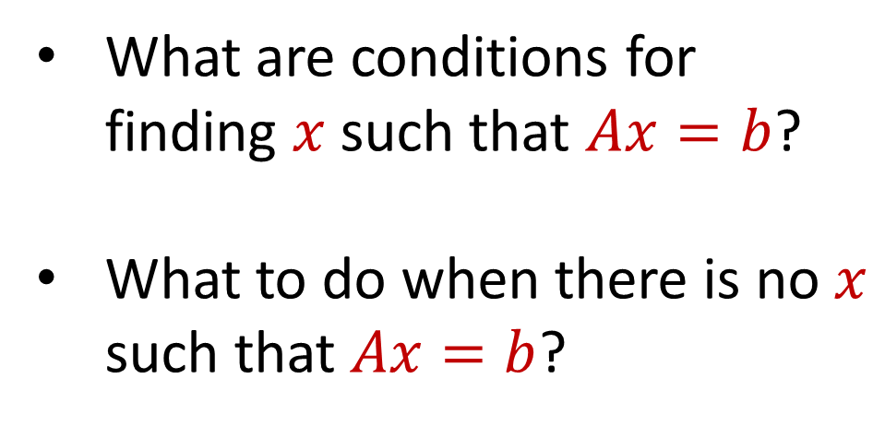
Regression
What are conditions for finding $x$ such that $Ax=b$?
What to do when there is no $x$ such that $Ax=b$?
$$d$$
$$x$$
$$=$$
$$n$$
$$A$$
$$n$$
$$b$$
$$1$$
$$d$$
$$1$$

Slide 59
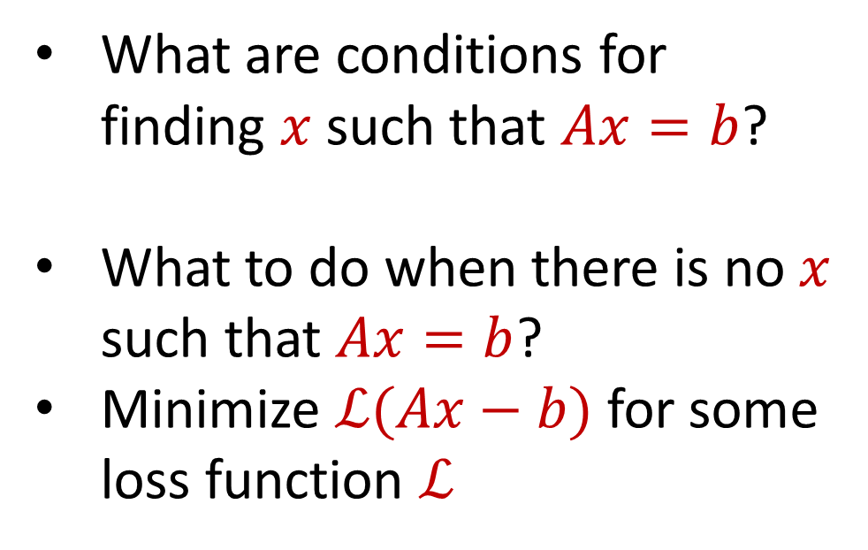
Regression
What are conditions for finding $x$ such that $Ax=b$?
What to do when there is no $x$ such that $Ax=b$?
Minimize $ℒ(Ax−b)$ for some loss function $ℒ$
$$d$$
$$x$$
$$=$$
$$n$$
$$A$$
$$n$$
$$b$$
$$1$$
$$d$$
$$1$$

Slide 60
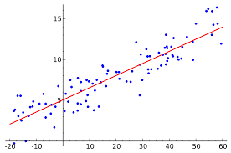
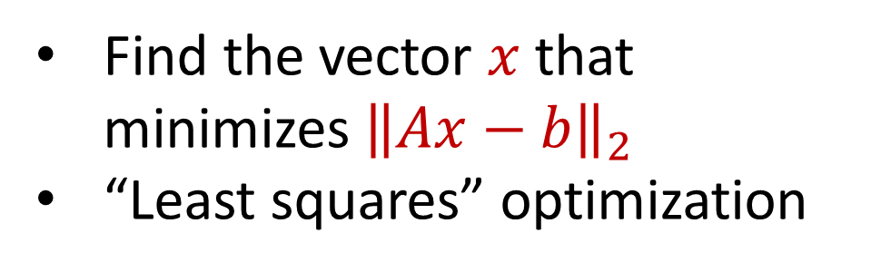
Linear Regression
Find the vector $x$ that minimizes ${\left\|Ax−b\right\|}_{2}$
“Least squares” optimization
$$d$$
$$x$$
$$≈$$
$$n$$
$$A$$
$$n$$
$$b$$
$$1$$
$$d$$
$$1$$

Slide 61
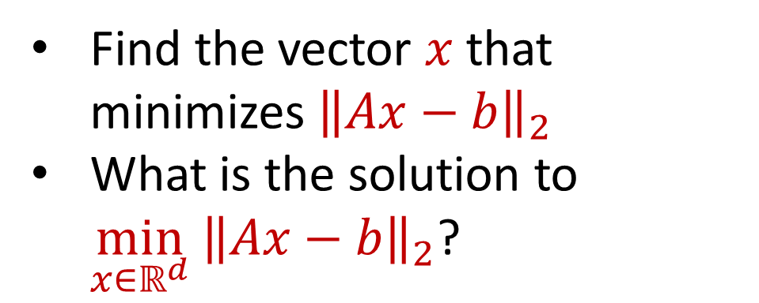
Linear Regression
Find the vector $x$ that minimizes ${\left\|Ax−b\right\|}_{2}$
What is the solution to $\min_{x∈ℝ^{d}} {\left\|Ax−b\right\|}_{2}$?
$$d$$
$$x$$
$$≈$$
$$n$$
$$A$$
$$n$$
$$b$$
$$1$$
$$d$$
$$1$$

Slide 62
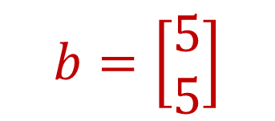
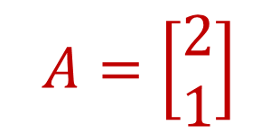
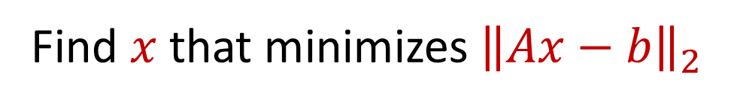
Linear Regression
$$b=\left[\begin{aligned}5 \\ 5\end{aligned}\right]$$
$$A=\left[\begin{aligned}2 \\ 1\end{aligned}\right]$$
Find $x$ that minimizes ${\left\|Ax−b\right\|}_{2}$

Slide 63
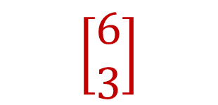
Linear Regression
$$b=\left[\begin{aligned}5 \\ 5\end{aligned}\right]$$
$$\left[\begin{aligned}6 \\ 3\end{aligned}\right]$$
$$A=\left[\begin{aligned}2 \\ 1\end{aligned}\right]$$
Find $x$ that minimizes ${\left\|Ax−b\right\|}_{2}$

Slide 64
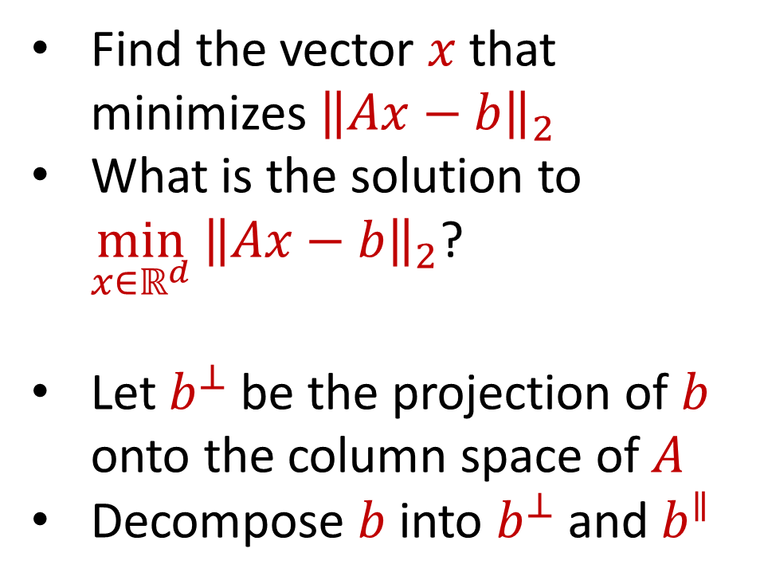
Linear Regression
Find the vector $x$ that minimizes ${\left\|Ax−b\right\|}_{2}$
What is the solution to $\min_{x∈ℝ^{d}} {\left\|Ax−b\right\|}_{2}$?
Let $b^{⊥}$ be the projection of $b$ onto the column space of $A$
Decompose $b$ into $b^{⊥}$ and $b^{∥}$
$$d$$
$$x$$
$$≈$$
$$n$$
$$A$$
$$n$$
$$b$$
$$1$$
$$d$$
$$1$$

Slide 65
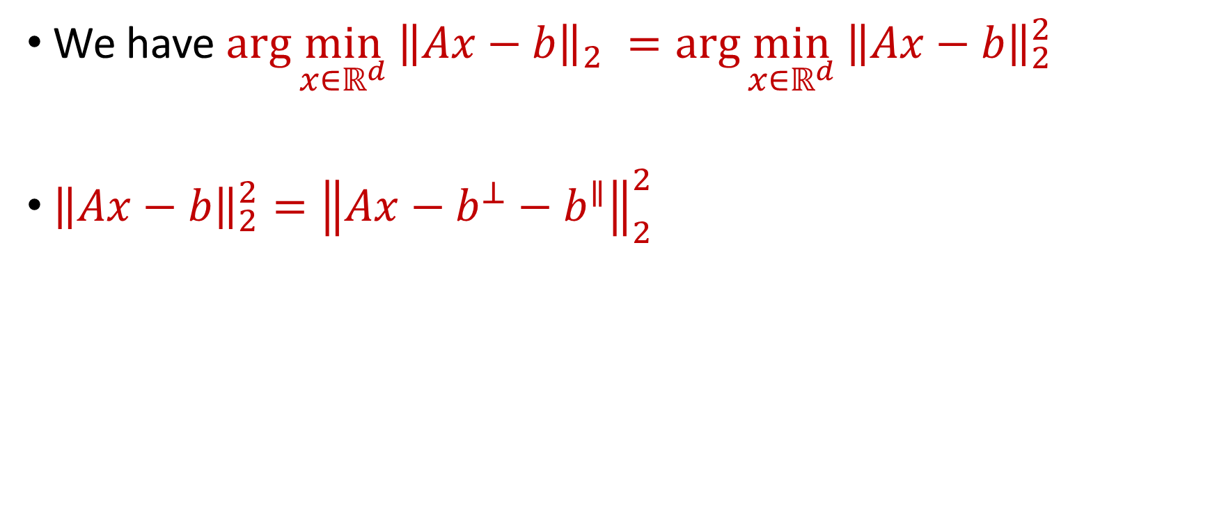
Linear Regression
We have $\arg{\min_{x∈ℝ^{d}} {\left\|Ax−b\right\|}_{2} }=\arg{\min_{x∈ℝ^{d}} {\left\|Ax−b\right\|}_{2}^{2} }$
${\left\|Ax−b\right\|}_{2}^{2}={\left\|Ax−b^{⊥}−b^{∥}\right\|}_{2}^{2}$

Slide 66
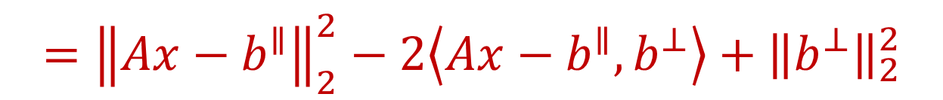
Linear Regression
We have $\arg{\min_{x∈ℝ^{d}} {\left\|Ax−b\right\|}_{2} }=\arg{\min_{x∈ℝ^{d}} {\left\|Ax−b\right\|}_{2}^{2} }$
${\left\|Ax−b\right\|}_{2}^{2}={\left\|Ax−b^{⊥}−b^{∥}\right\|}_{2}^{2}$
$$={\left\|Ax−b^{∥}\right\|}_{2}^{2}−2\left\langle Ax−b^{∥},b^{⊥}\right\rangle +{\left\|b^{⊥}\right\|}_{2}^{2}$$

Slide 67
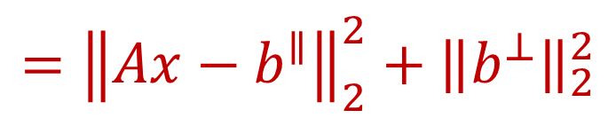
Linear Regression
We have $\arg{\min_{x∈ℝ^{d}} {\left\|Ax−b\right\|}_{2} }=\arg{\min_{x∈ℝ^{d}} {\left\|Ax−b\right\|}_{2}^{2} }$
${\left\|Ax−b\right\|}_{2}^{2}={\left\|Ax−b^{⊥}−b^{∥}\right\|}_{2}^{2}$
$$={\left\|Ax−b^{∥}\right\|}_{2}^{2}−2\left\langle Ax−b^{∥},b^{⊥}\right\rangle +{\left\|b^{⊥}\right\|}_{2}^{2}$$
$$={\left\|Ax−b^{∥}\right\|}_{2}^{2}+{\left\|b^{⊥}\right\|}_{2}^{2}$$

Slide 68
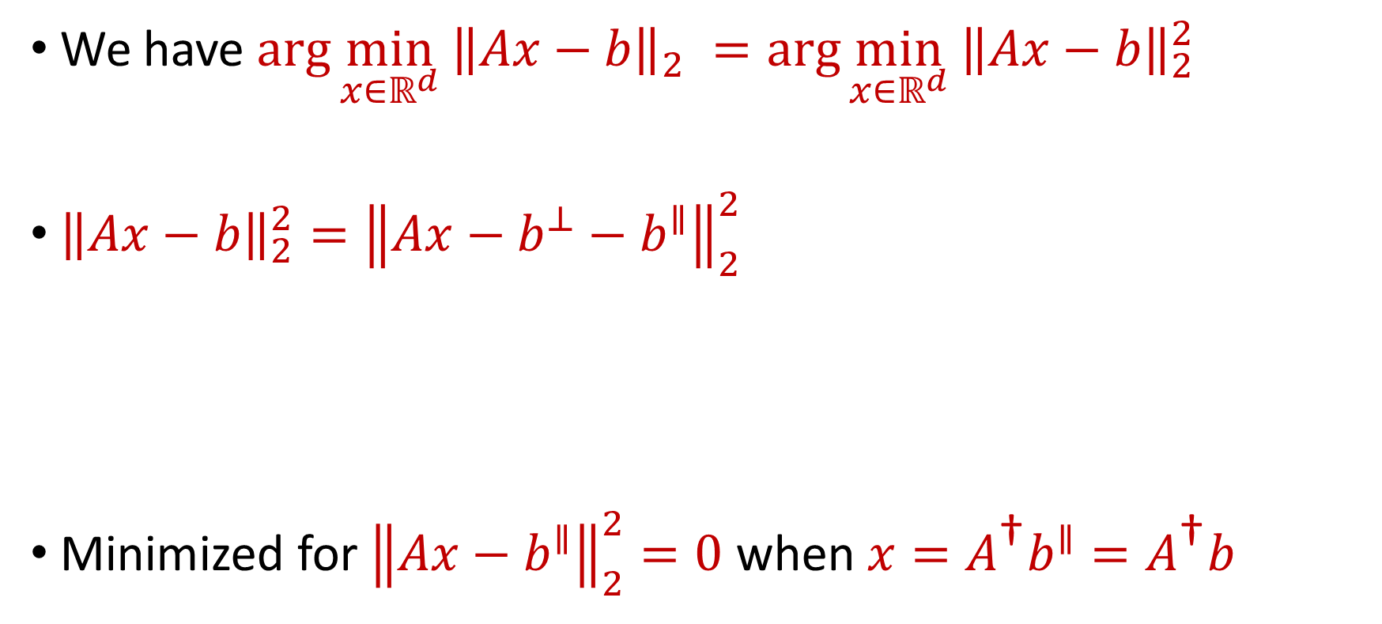
Linear Regression
We have $\arg{\min_{x∈ℝ^{d}} {\left\|Ax−b\right\|}_{2} }=\arg{\min_{x∈ℝ^{d}} {\left\|Ax−b\right\|}_{2}^{2} }$
${\left\|Ax−b\right\|}_{2}^{2}={\left\|Ax−b^{⊥}−b^{∥}\right\|}_{2}^{2}$
Minimized for ${\left\|Ax−b^{∥}\right\|}_{2}^{2}=0$ when $x=A^{\text{†}}b^{∥}=A^{\text{†}}b$
$$={\left\|Ax−b^{∥}\right\|}_{2}^{2}−2\left\langle Ax−b^{∥},b^{⊥}\right\rangle +{\left\|b^{⊥}\right\|}_{2}^{2}$$
$$={\left\|Ax−b^{∥}\right\|}_{2}^{2}+{\left\|b^{⊥}\right\|}_{2}^{2}$$

Slide 69
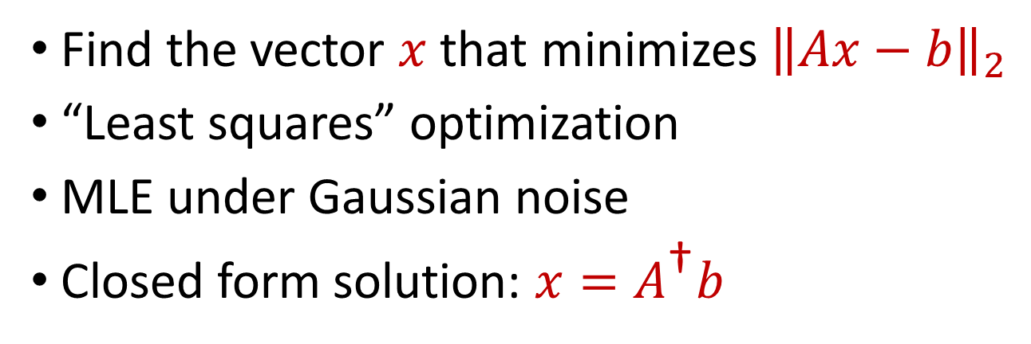
Linear Regression
Find the vector $x$ that minimizes ${\left\|Ax−b\right\|}_{2}$
“Least squares” optimization
MLE under Gaussian noise
Closed form solution: $x=A^{\text{†}}b$
$$d$$
$$x$$
$$≈$$
$$n$$
$$A$$
$$n$$
$$b$$
$$1$$
$$d$$
$$1$$

Slide 70
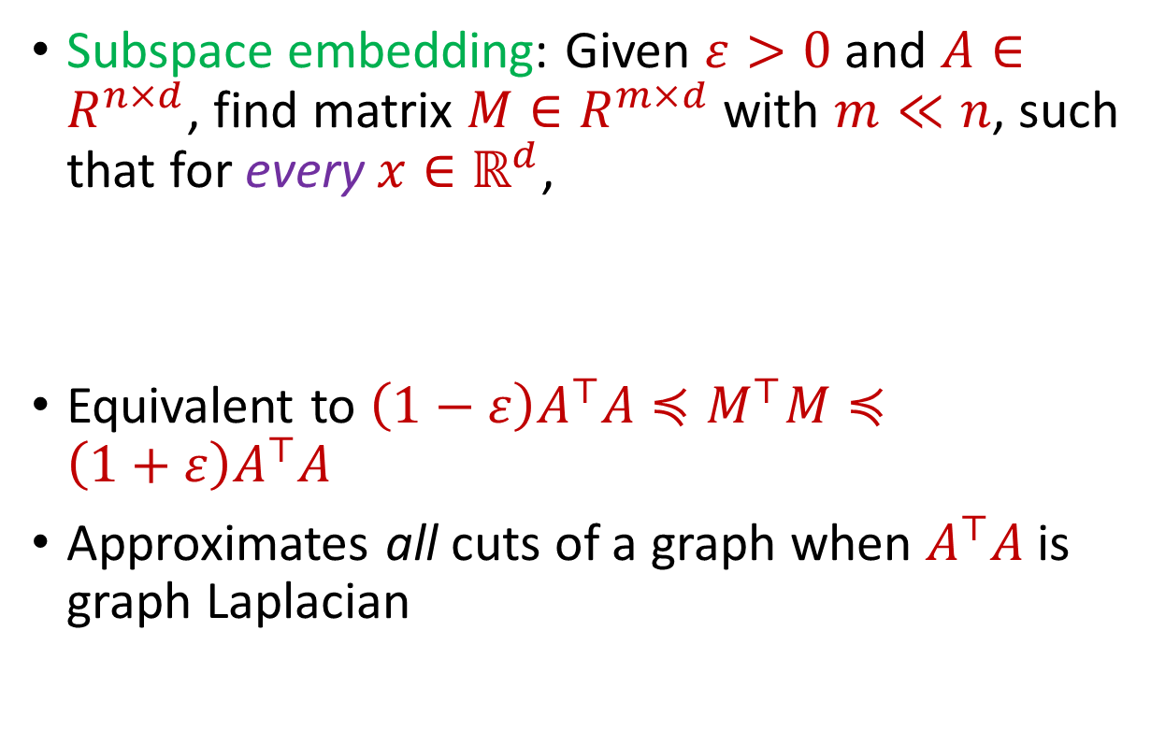

Subspace Embedding
Subspace embedding: Given $ε>0$ and $A∈R^{n×d}$, find matrix $M∈R^{m×d}$ with $m≪n$, such that for every $x∈ℝ^{d}$,
Equivalent to $\left(1−ε\right)A^{⊤}A≼M^{⊤}M≼\left(1+ε\right)A^{⊤}A$
Approximates all cuts of a graph when $A^{⊤}A$ is graph Laplacian
$$A$$
$$x$$
$$n$$
$$\left(1−ε\right){\left\|Ax\right\|}_{2}≤{\left\|Mx\right\|}_{2}≤\left(1+ε\right){\left\|Ax\right\|}_{2}$$
$$d$$

Slide 71

Subspace Embedding
Subspace embedding: Given $ε>0$ and $A∈R^{n×d}$, find matrix $M∈R^{m×d}$ with $m≪n$, such that for every $x∈ℝ^{d}$,
Claim: A construction of a subspace embedding can be used to approximately solve linear regression
$$A$$
$$x$$
$$n$$
$$\left(1−ε\right){\left\|Ax\right\|}_{2}≤{\left\|Mx\right\|}_{2}≤\left(1+ε\right){\left\|Ax\right\|}_{2}$$
$$d$$

Slide 72
















Regression and Subspace Embeddings
Recall: Goal is to find $x$ that minimizes ${\left\|Ax−b\right\|}_{2}$
$$−$$
$$A$$
$$x$$
$$b$$
$$A$$
$$b$$
$$x$$
$$n$$
$$n$$
$$n$$
$$−1$$
$$d$$
$$1$$
$$d$$
$$1$$

Slide 73




Regression and Subspace Embeddings
Recall: Goal is to find $x$ that minimizes ${\left\|Ax−b\right\|}_{2}$
$$B$$
$$y$$
$$A$$
$$b$$
$$x$$
$$n$$
$$n$$
$$−1$$
$$d+1$$
$$d$$
$$1$$

Slide 74

Regression and Subspace Embeddings
Recall: Goal is to find $x$ that minimizes ${\left\|Ax−b\right\|}_{2}$
$$B$$
$$y$$
$$A$$
$$b$$
$$x$$
$$n$$
$$n$$
$$−1$$
$${\left\|By\right\|}_{2}≈{\left\|Ax−b\right\|}_{2}$$
$$d+1$$
$$d$$
$$1$$

Slide 75

Previously: Coreset Construction and Sampling
Importance sampling only needs $X′$ to have size $O\left(\frac{1}{ε^{2}}\right)$ to achieve $\left(1+ε\right)$-approximation to $Cost(X,C)$
To handle all possible sets of $k$ centers:
Need to sample each point $x$ with probability $\max_{C}\frac{Cost\left(x,C\right)}{Cost\left(X,C\right)}$ instead of $\frac{Cost\left(x,C\right)}{Cost\left(X,C\right)}$
Need to union bound over a net of all possible sets of $k$ centers
Net with size ${\left(\frac{nΔ}{ε}\right)}^{O(kd)}$

Slide 76
Previously: Sensitivity Sampling
The quantity $s\left(x\right)=\max_{C}\frac{Cost\left(x,C\right)}{Cost\left(X,C\right)}$ is called the sensitivity of $x$ and intuitively measures how “important” the point $x$ is
The total sensitivity of $X$ is $\sum_{x∈X}{s(x)}$ and quantifies how many points will be sampled into $X′$ through importance/sensitivity sampling (before the union bound)

Slide 77

Previously: Sensitivity Sampling
Recall: $\frac{kd}{ε^{2}}⋅\log{\frac{nΔ}{ε}}⋅\sum_{x∈X}{s(x)}$ points sampled
$\sum_{x∈X}{s(x)}=O_{z}(k)$
In total, roughly $\frac{k^{2}d}{ε^{2}}⋅\log{\frac{nΔ}{ε}}$ points sampled in expectation

Slide 78

Subspace Embedding
Subspace embedding: Given $ε>0$ and $A∈R^{n×d}$, find matrix $M∈R^{m×d}$ with $m≪n$, such that for every $x∈ℝ^{d}$,
$$A$$
$$x$$
$$n$$
$$\left(1−ε\right){\left\|Ax\right\|}_{2}≤{\left\|Mx\right\|}_{2}≤\left(1+ε\right){\left\|Ax\right\|}_{2}$$
$$d$$

Slide 79

Subspace Embedding
Subspace embedding: Given $ε>0$ and $A∈R^{n×d}$, find matrix $M∈R^{m×d}$ with $m≪n$, such that for every $x∈ℝ^{d}$,
Recall: ${\left\|Ax\right\|}_{2}^{2}={\left\langle a_{1}, x\right\rangle }^{2}+…+{\left\langle a_{n}, x\right\rangle }^{2}$
$$A$$
$$x$$
$$n$$
$$\left(1−ε\right){\left\|Ax\right\|}_{2}^{2}≤{\left\|Mx\right\|}_{2}^{2}≤\left(1+ε\right){\left\|Ax\right\|}_{2}^{2}$$
$$d$$

Slide 80

Subspace Embedding
Subspace embedding: Given $ε>0$ and $A∈R^{n×d}$, find matrix $M∈R^{m×d}$ with $m≪n$, such that for every $x∈ℝ^{d}$,
Question: For a fixed $x∈ℝ^{d}$, how would we produce a matrix $M$ such that ${\left\|Mx\right\|}_{2}^{2}≈{\left\|Ax\right\|}_{2}^{2}$?
$$\left(1−ε\right){\left\|Ax\right\|}_{2}^{2}≤{\left\|Mx\right\|}_{2}^{2}≤\left(1+ε\right){\left\|Ax\right\|}_{2}^{2}$$

Slide 81


Leverage Scores
Intuition: how unique a row is (recall importance sampling)
$ℓ_{i}=\max{\frac{{\left\langle a_{i},x\right\rangle }^{2}}{{\left\|Ax\right\|}_{2}^{2}}}$ are the leverage scores of $A$ (in this case of row $a_{i}$ )
Take $x=(1 −1)$ to see that $ℓ_{1}=1$
Take $x=(0 1)$ to see that $ℓ_{2}=1$
1 0
1 1
$ℓ_{i}=a_{i}{\left(A^{⊤}A\right)}^{−1}a_{i}^{⊤}$, ${∑ℓ}_{i}=d$
$$A$$
$$a_{i}$$

Slide 82


census.gov:

Slide 83


Private Data Analysis
Sensitive dataset
Analyst
Analysis of medical datasets to predict possible issues
Pattern detection for social networks or epidemic spread
US Census information for apportionment

Slide 84

Anonymization
Sensitive dataset
Anonymized dataset
Analyst

Slide 85
Anonymizing Data
Age | Zip Code | Employer | Has Pet
56 | 77005 | Apple | Yes
32 | 77005 | Microsoft | No
71 | 77005 | Amazon | Yes
44 | 77005 | Petsmart | Yes
25 | 77005 | Netflix | No
61 | 77005 | Google | No

Slide 86
Anonymizing Data
Age | Zip Code | Employer | Has Pet
56 | 77005 | Apple | Yes
32 | 77005 | Microsoft | No
71 | 77005 | Amazon | Yes
44 | 77005 | Petsmart | Yes
25 | 77005 | Netflix | No
61 | 77005 | Google | No
Name | Age | Gender | Employer
Alice | 56 | Female | Apple
Bob | 32 | Male | Microsoft
Carol | 71 | Female | Amazon
Dale | 44 | Male | Petsmart
Erin | 25 | Female | Netflix
Fred | 61 | Male | Google

Slide 87
Reconstruction Attack
Name | Age | Zip Code | Gender | Employer | Has Pet
Alice | 56 | 77005 | Female | Apple | Yes
Bob | 32 | 77005 | Male | Microsoft | No
Carol | 71 | 77005 | Female | Amazon | Yes
Dale | 44 | 77005 | Male | Petsmart | Yes
Erin | 25 | 77005 | Female | Netflix | No
Fred | 61 | 77005 | Male | Google | No

Slide 88

Anonymizing Data

Slide 89

Image from Arvind Narayanan

Slide 90
Differencing Attacks
How many people in this classroom went to Kyle Field last weekend?
How many people in this classroom besides the instructor went to Kyle Field last weekend?

Slide 91

Slide from Steven Wu

Slide 92

2010 US Census
$308,745,738$ people $×$ $6$ variables = $1,852,473,228$ measurements collected
Total statistics: $5,578,897,932$
Create a system of $5.5$ billion equations with $1.8$ billion unknowns

Slide 93


2010 US Census
Reconstruction attack on 2010 US Census by researchers recovered information for $308,745,538$ people using census block and tract summary tables

Slide 94
Summary
“Ad-hoc” privacy procedures like anonymization/deidentification often fails
Publishing too many queries on a sensitive database with too much accuracy can compromise the privacy of the database
Need a formal mathematical notion for measuring privacy

Slide 95

Possible Notion for Privacy #1
“The data analyst cannot learn anything about Alice”
Sensitive dataset
Analyst

Slide 96
Possible Notion for Privacy #1
“The data analyst cannot learn anything about Alice”
Most Aggies like Reveille
Alice is known to be an Aggie
Sensitive dataset
Analyst
Was Alice’s privacy violated?

Slide 97

Possible Notion for Privacy #1
“The data analyst cannot learn anything about Alice”
Most Aggies like Reveille
Bob participates in the survey
Sensitive dataset
Analyst
Even though Alice is not in the survey, it is still known that Alice is an Aggie

Slide 98
Possible Notion for Privacy #1
Suppose a survey is conducted on a sensitive dataset and concludes that “most Aggies like Reveille”
Alice is a known Aggie, and so a data analyst infers that Alice is more likely to be a dog owner and asks for higher apartment cleaning rates
Was Alice’s privacy violated by this study?

Slide 99
Possible Notion for Privacy #2
“A study is private…if the data analyst gains almost no additional information about Alice from the study than if the same study was performed without Alice’s data”

Slide 100

Possible Notion for Privacy #2
Stability: the data analyst reaches roughly similar conclusions if any individual data point is replaced by another data point of the population

Slide 101




Differential Privacy
[DMNS06] Given $ε>0$and $δ∈\left(0,1\right)$, a randomized algorithm $A:U^{∗}→Y$ is $(ε,δ)$-differentially private if, for every neighboring frequency vectors $f$ and $f′$ and for all $E⊆Y$,
$$Pr\left[A\left(f\right)∈E\right]≤e^{ε}Pr\left[A\left(f^{′}\right)∈E\right]+δ$$
$$A\left( \right)≈A\left( \right)$$
Notes:
[DworkMcSherryNissimSmith06]

Slide 102

Differential Privacy
[DMNS06] Given $ε>0$and $δ∈\left(0,1\right)$, a randomized algorithm $A:U^{∗}→Y$ is $(ε,δ)$-differentially private if, for every neighboring frequency vectors $f$ and $f′$ and for all $E⊆Y$,
$$Pr\left[A\left(f\right)∈E\right]≤e^{ε}Pr\left[A\left(f^{′}\right)∈E\right]+δ$$
Sensitive dataset
Algorithm
Output distribution
Notes:
[DworkMcSherryNissimSmith06]

